Slide 1



ME150: Manufacturing
Dr. Pankaj Kumar
Department of Mechanical Engineering
National Institute of Technology Goa

Slide 2
Joining Process
Mechanical
Assembly
(Threaded
joints
Fasteners
Rivets)
Welding
Brazing
Soldering
Adhesive bonding

Slide 3
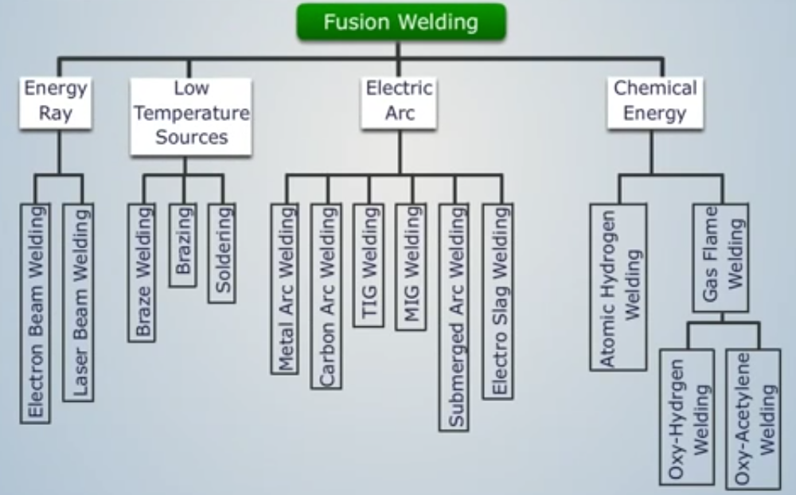

Slide 4
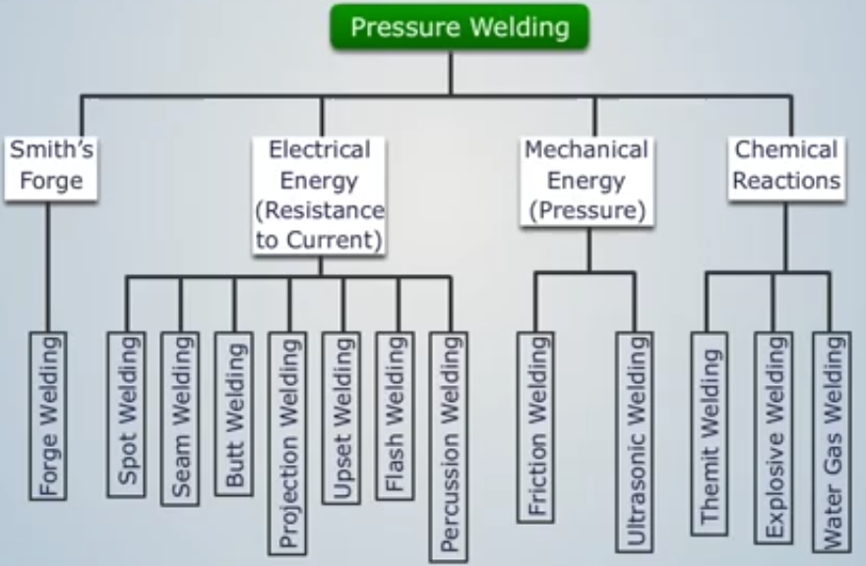

Slide 5
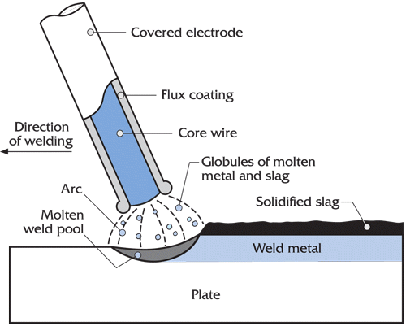
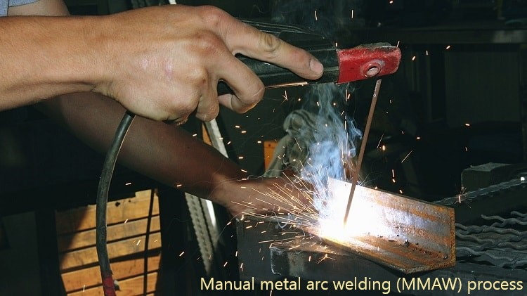
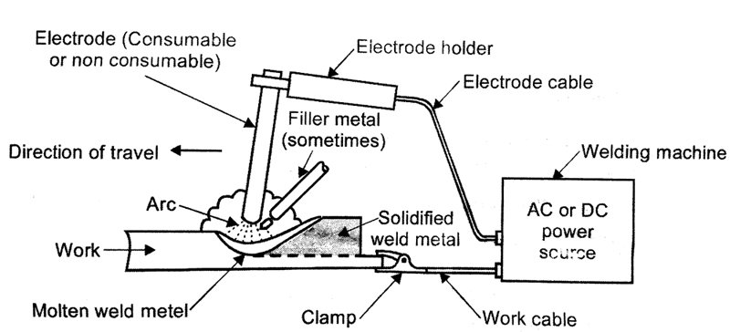
Fusion welding:
electric arc welding

Slide 6
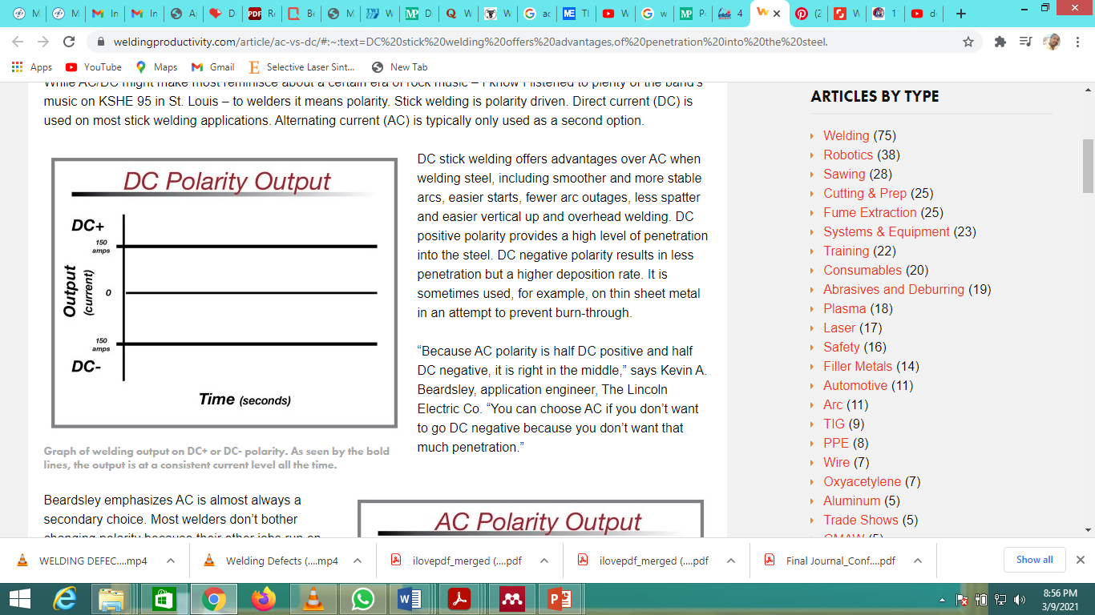
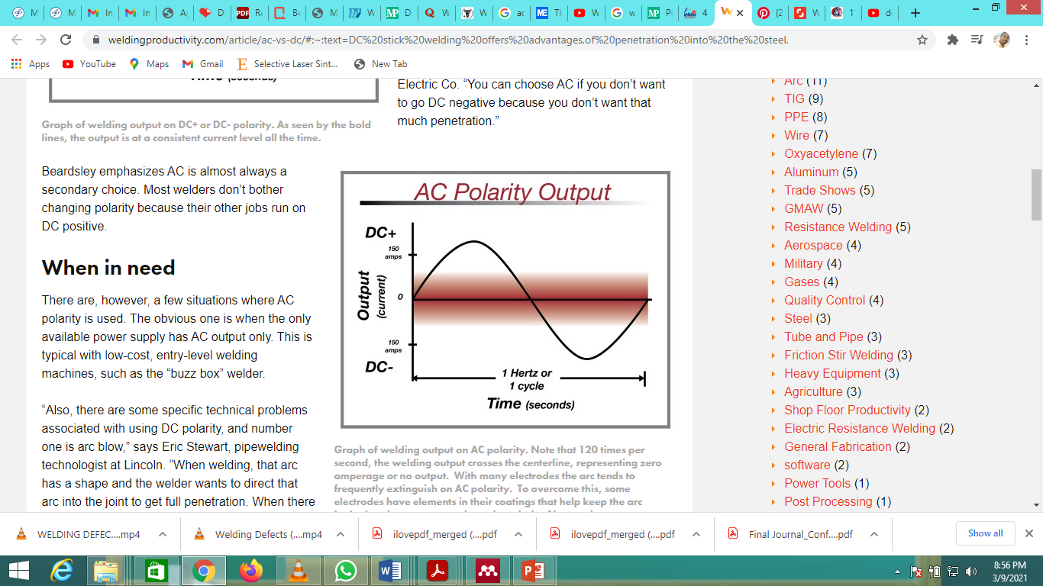
power source
Why not preferred???
Losing of arc Because the current fluctuates back and forth, the arc needs to restart itself at every turn of the current between positive and negative. Sometimes, the arc cannot restart itself, and you must manually restart it.
Spattering Spatter is the tiny bits of metal debris often found surrounding AC welds. This is a result of the fluctuating current as well.

Slide 7
Arc welding polarity: power source
Three different polarities used in arc welding
Direct Current Straight Polarity—occurs when electrode is made negative and base plates are made positive. Thus electrons flow from electrode tip to base plates.
Direct Current Reverse Polarity—occurs when electrode is made positive and base plates are made negative. Thus electrons flow from base plates to electrode.
Alternating Current Polarity—If power source provides AC current then above two cases will occur one after another in every cycle. In one half of the cycle, electrode will be negative (so base plates will be positive) and in the next half, electrode will be positive (so base plate will be negative). Number of cycles per second depends on frequency of supply. For example, with a 60Hz supply, 60 cycles occur in every second.
Direct Current Electrode Positive (DCEP) polarity
With direct current (DC) power supply, when electrode is connected with positive terminal and base plates with the negative terminal, then it is termed as Direct Current Electrode Positive (DCEP) or Direct Current Reverse Polarity (DCRP). So electrons liberate from base plate and flow towards electrode via the outer circuit. Continuous flow of avalanche of electrons in a small passage produces the arc (source of heat).

Slide 8
Difference between TIG and MIG welding

Slide 9
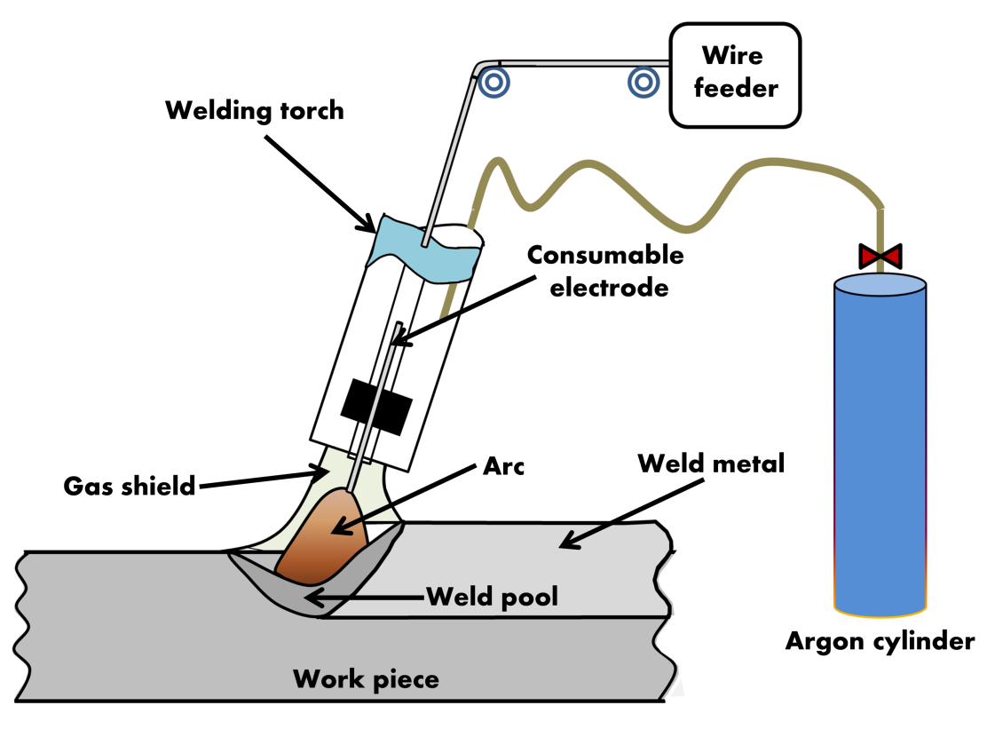
Fusion welding:
Metal inert gas welding
https://www.youtube.com/watch?v=3RkZ1GlnOhQ

Slide 10
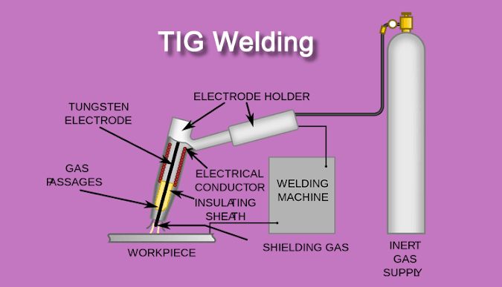
Fusion welding:
Tungsten inert gas welding
Advantages of TIG welding
Non-consumable electrodes: It helps in flawless joints
No flux is required because inert gas shields molten metal. So no slag and slag inclusion problems
High quality and strong welding achieved by TIG
Suitable for welding of very thin sections
Nonferrous metals like aluminium, copper and dissimilar metal can be welded without any challenge
Non-corrosive and ductile joints
Less distortion due to small heat zone.

Slide 11
Shielding Gas

Slide 12
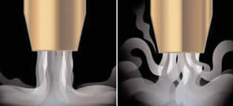
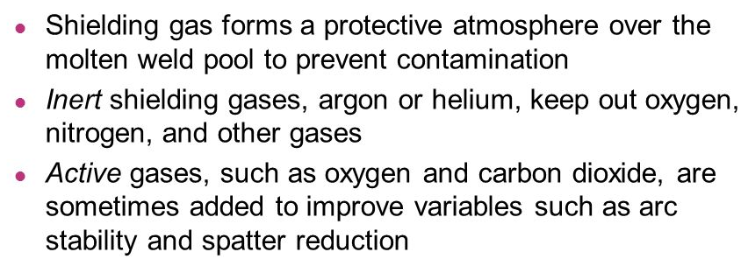
Types of Shielding gases

Slide 13
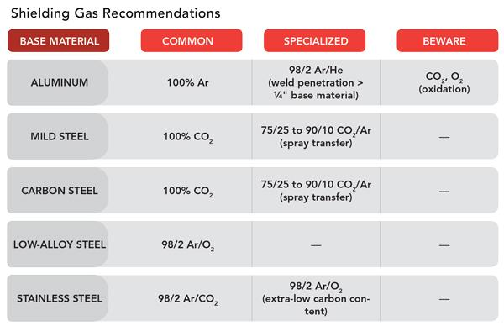
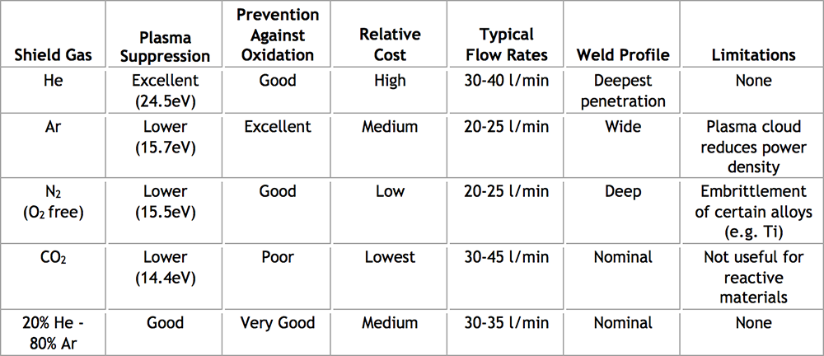
Types of Shielding gases

Slide 14
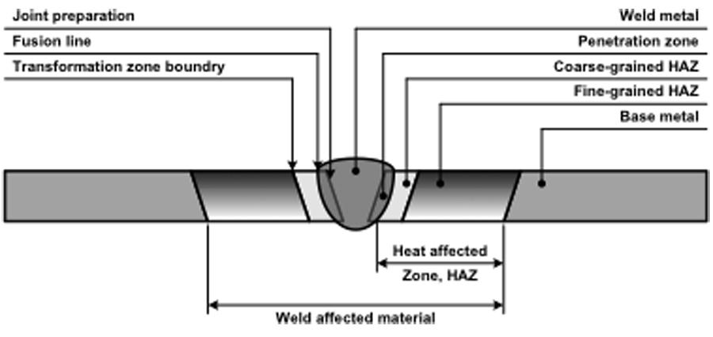
Heat affected zone (HAZ)

Slide 15
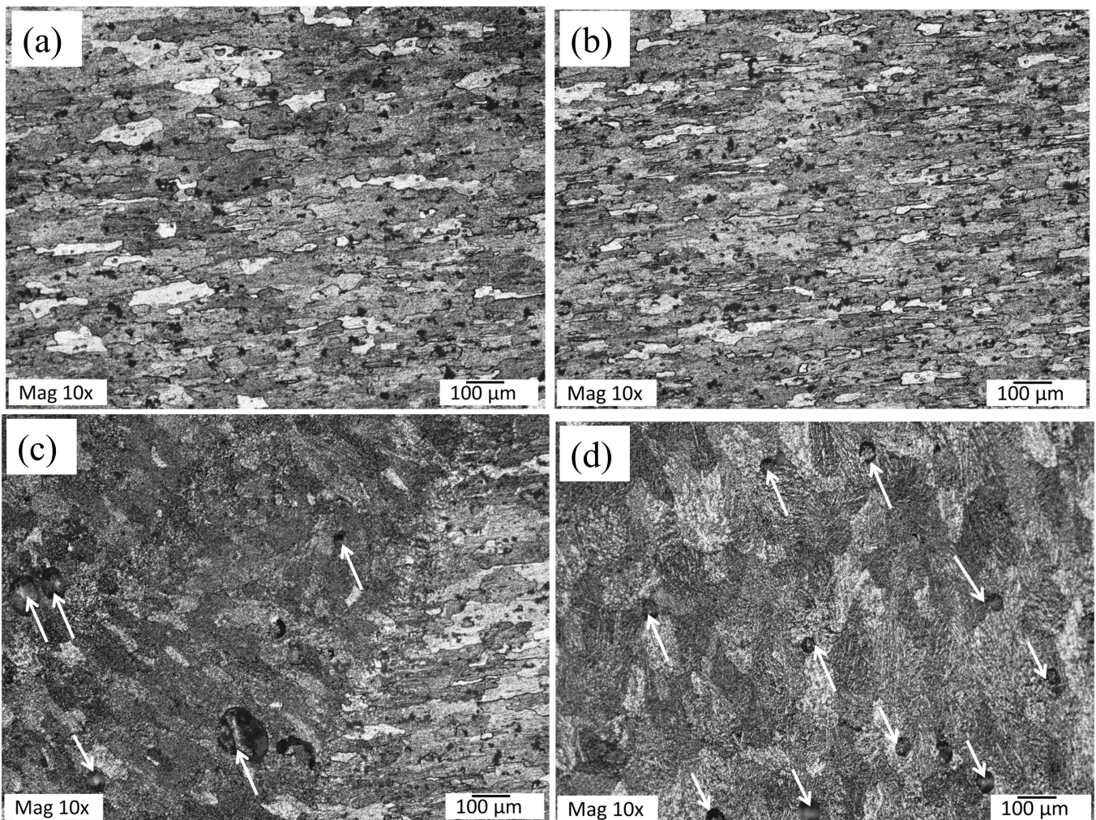
Different zones (AA 5754 Alloy)

Slide 16
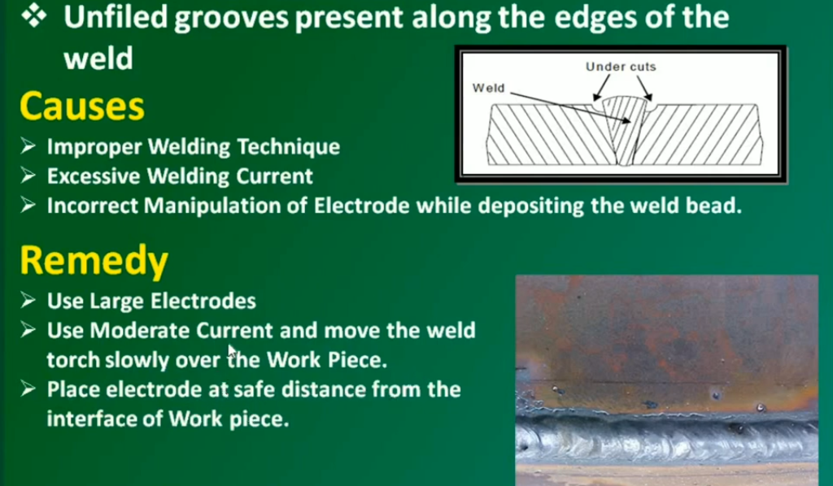
undercut

Slide 17
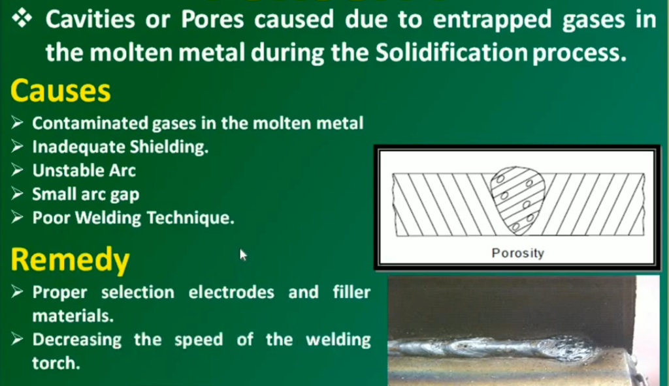
porosity

Slide 18
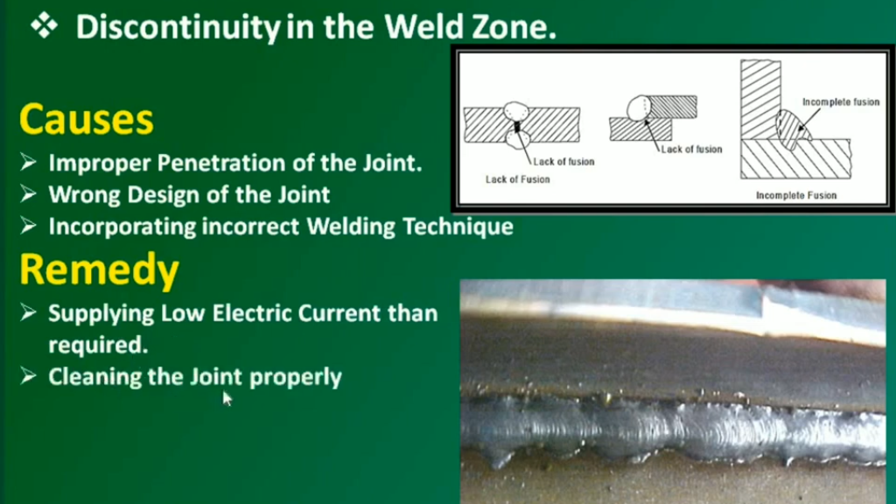
Incomplete fusion

Slide 19
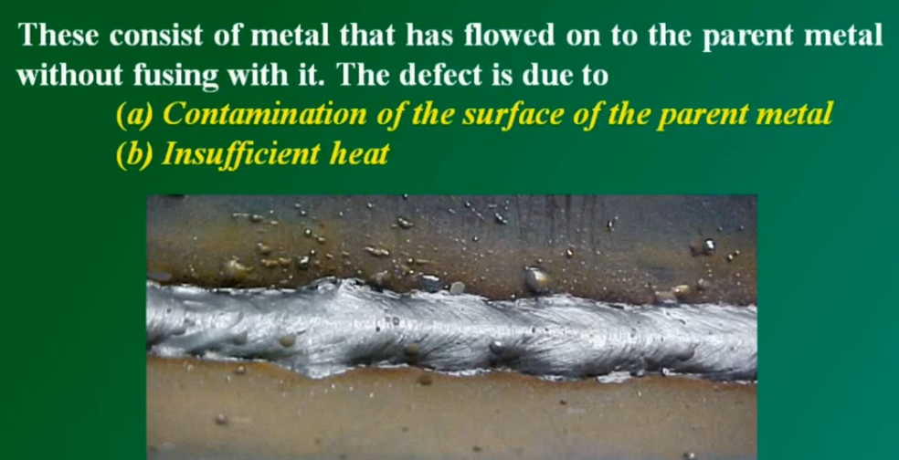
Overlap

Slide 20
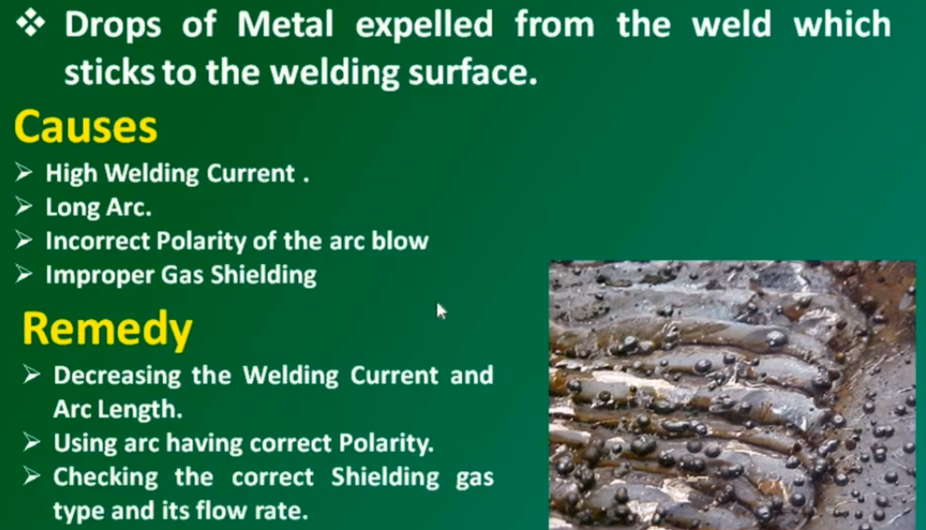
Spatter

Slide 21
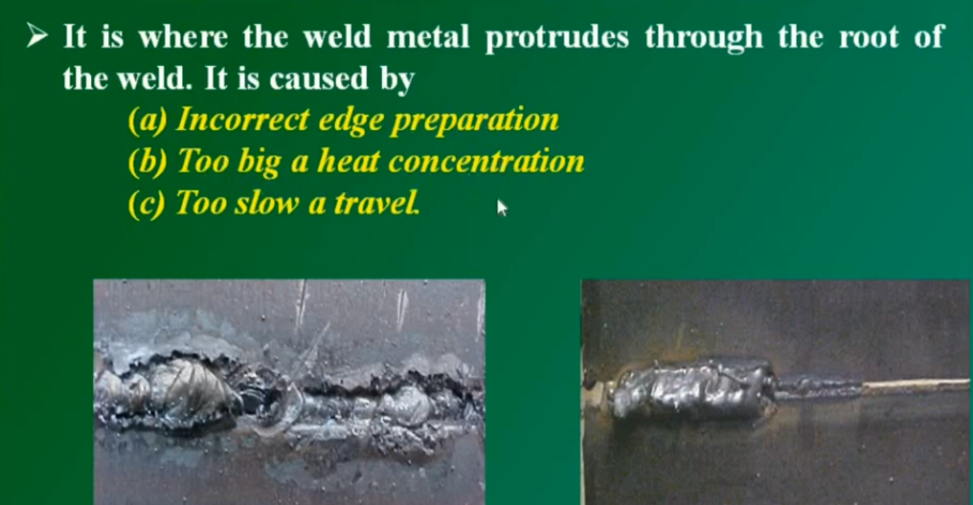
Incomplete and excessive penetration

Slide 22
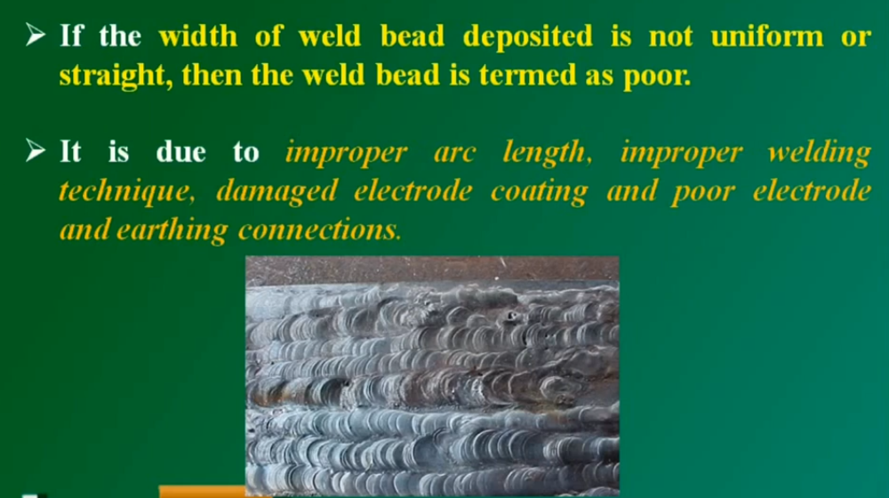
Unacceptable weld profile

Slide 23
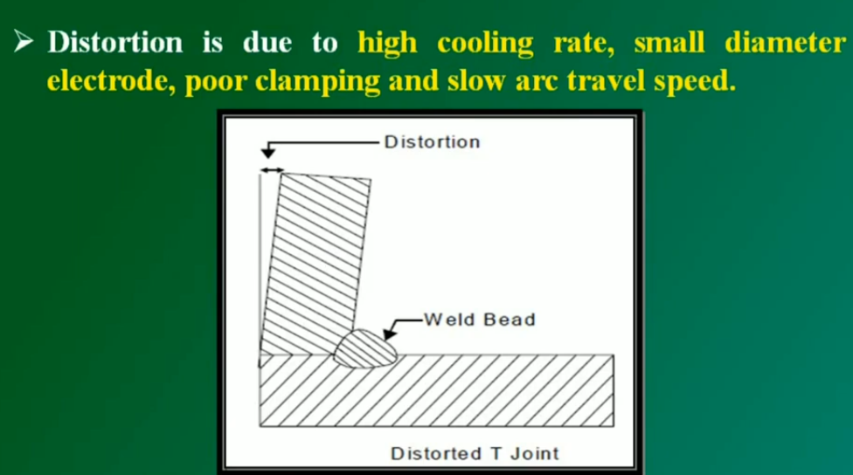
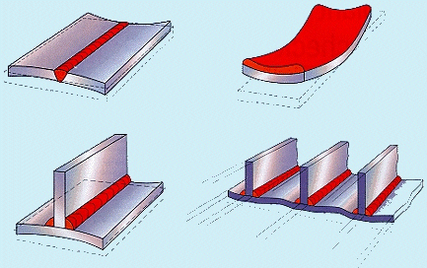
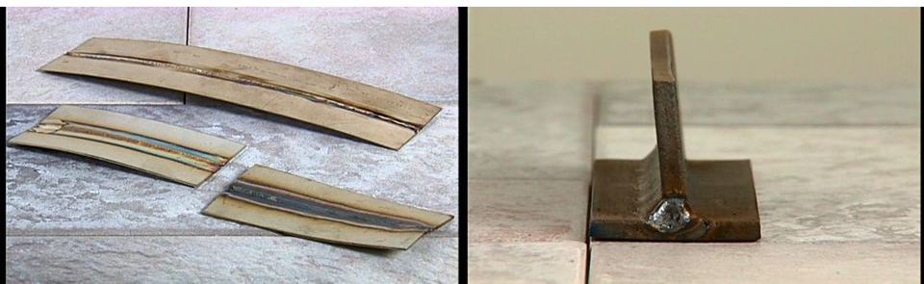
distortion

Slide 24
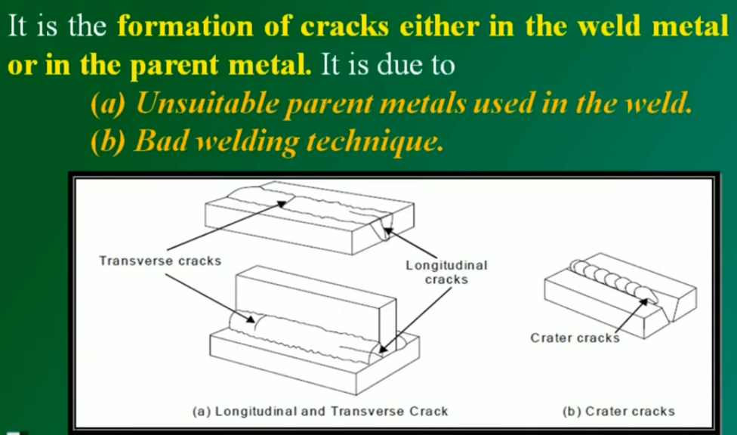
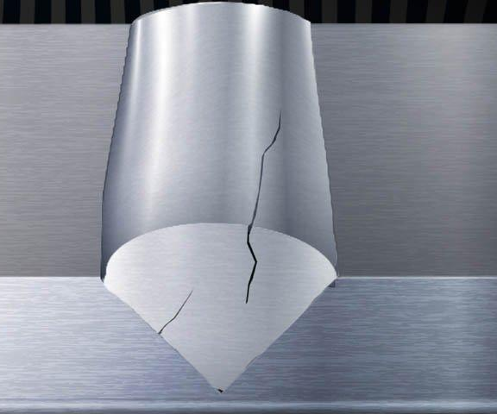
cracking

Slide 25
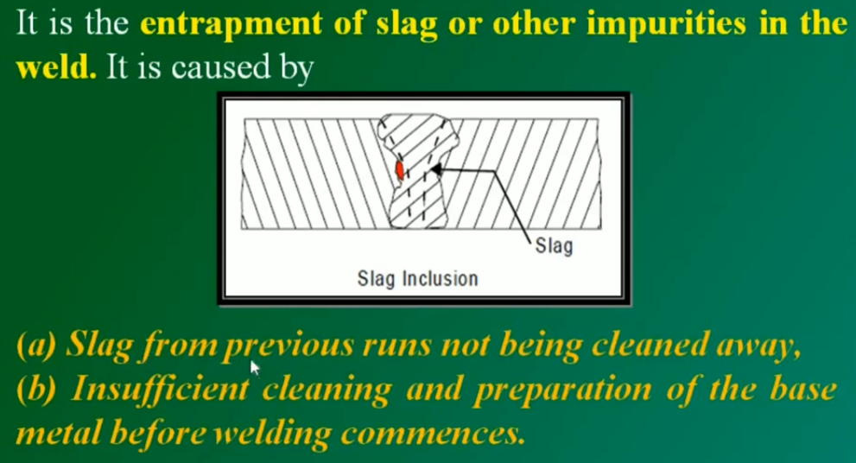
Slag inclusions

Slide 26
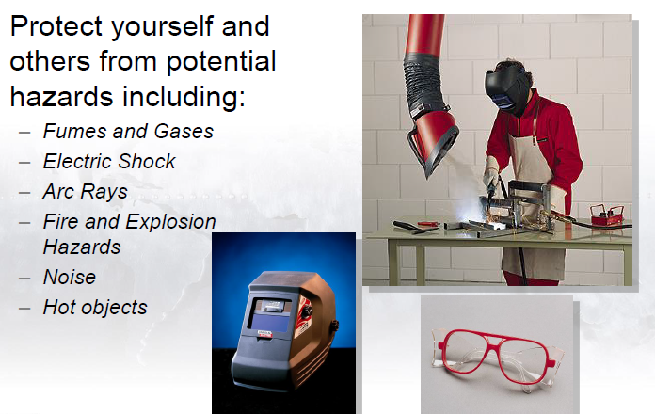
Safety & Precautions

Slide 27
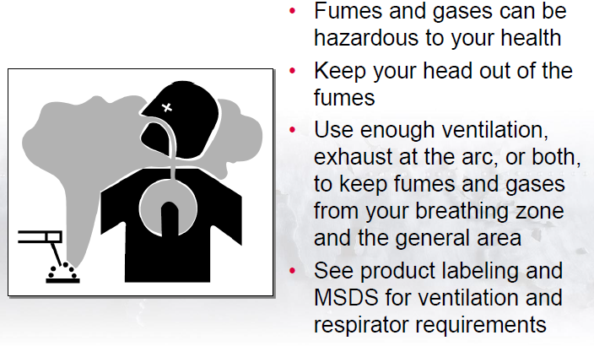
Fumes and gases

Slide 28
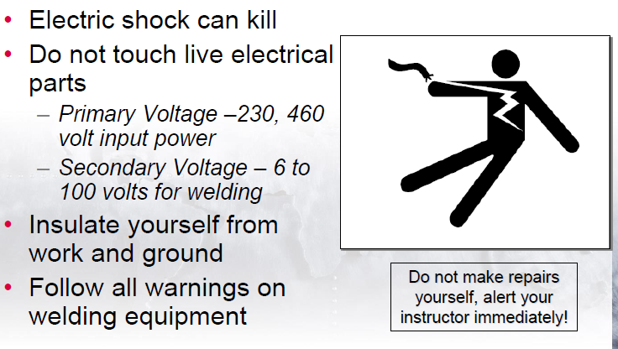
Electric shock

Slide 29
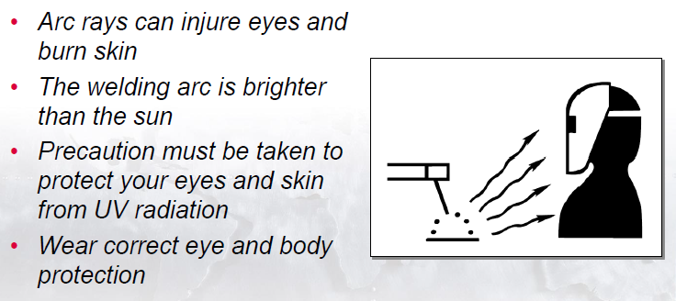
Arc rays

Slide 30
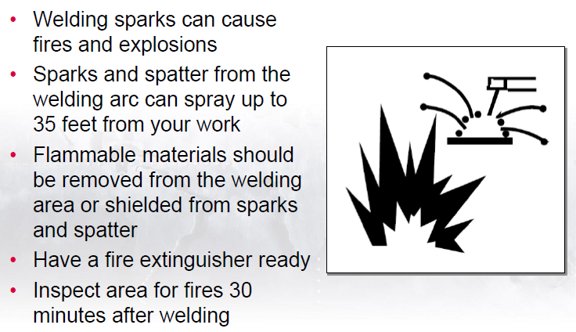
Fire and explosion hazards

Slide 31
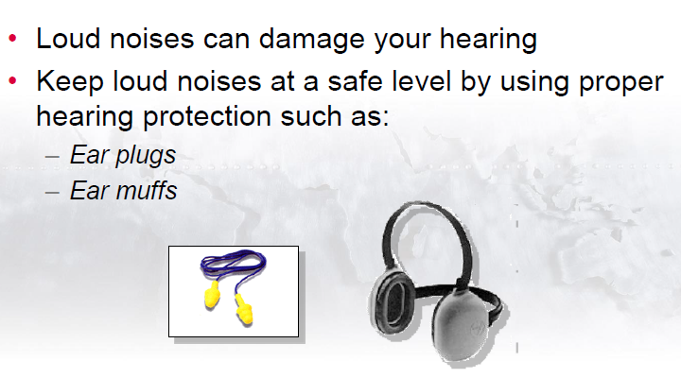
noise

Slide 32
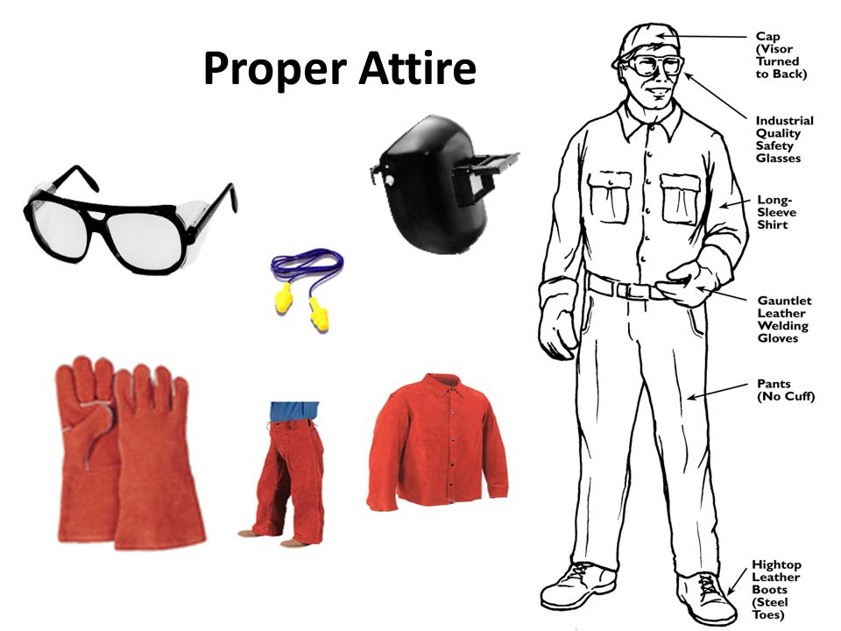
Welding safety equipments

Slide 33
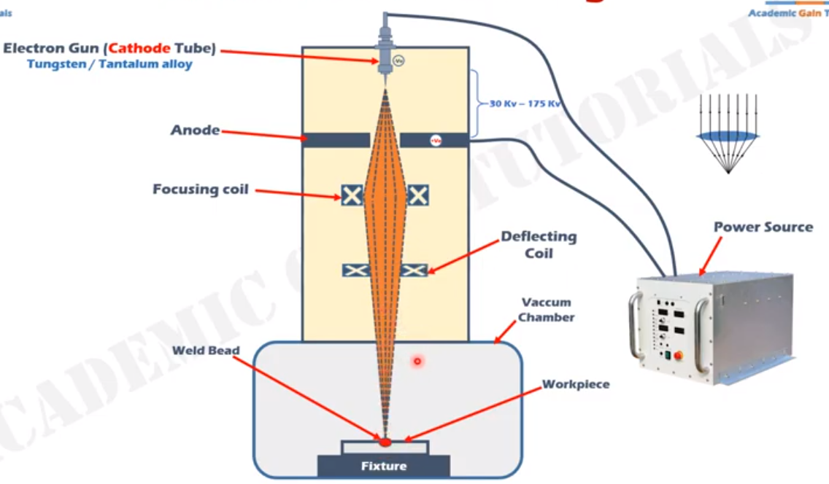
EBW: Electro beam welding

Slide 34
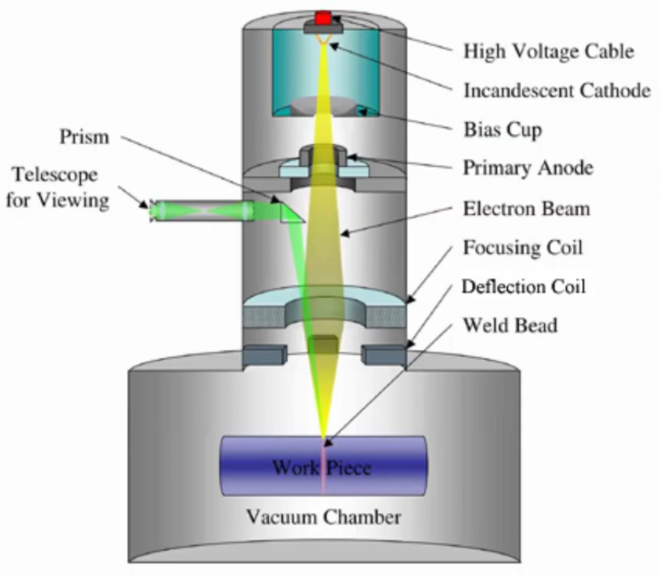
EBW: Electro beam welding

Slide 35
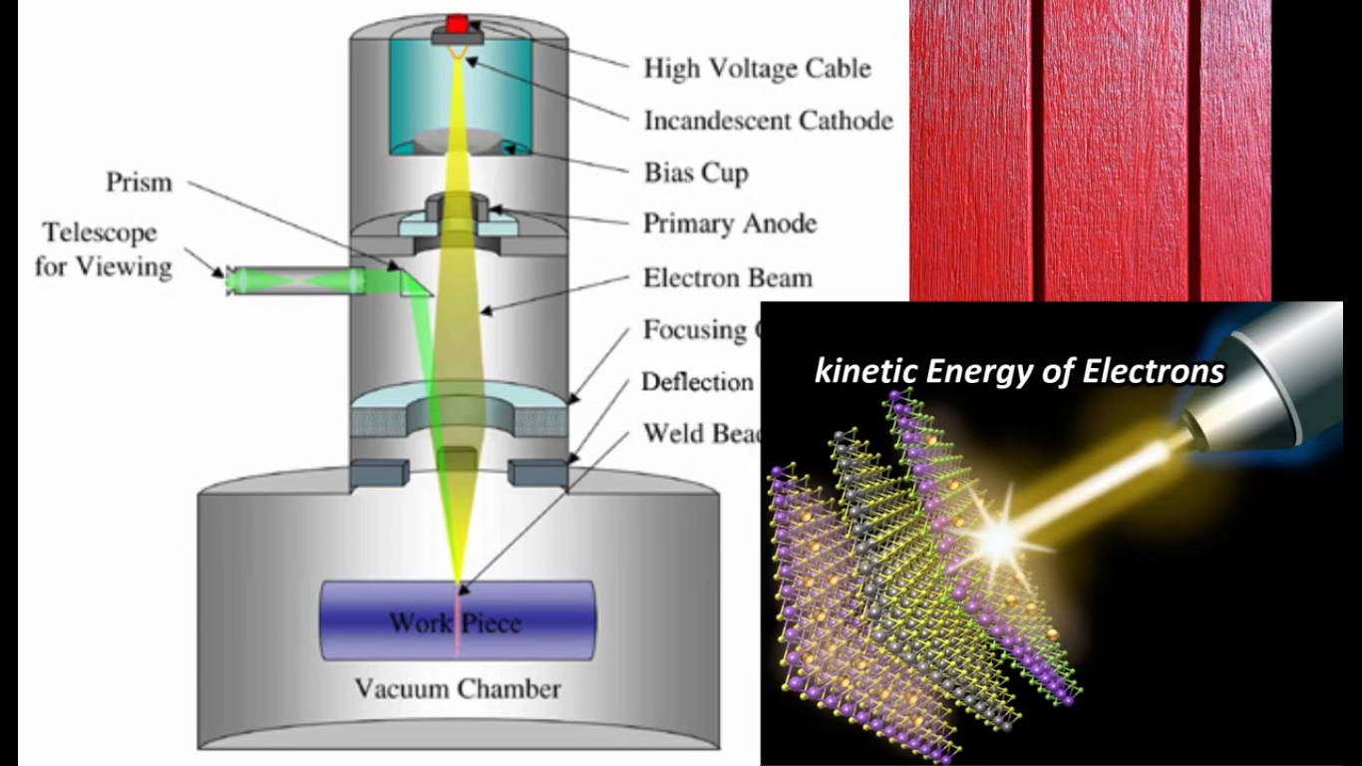
EBW: Electro beam welding

Slide 36
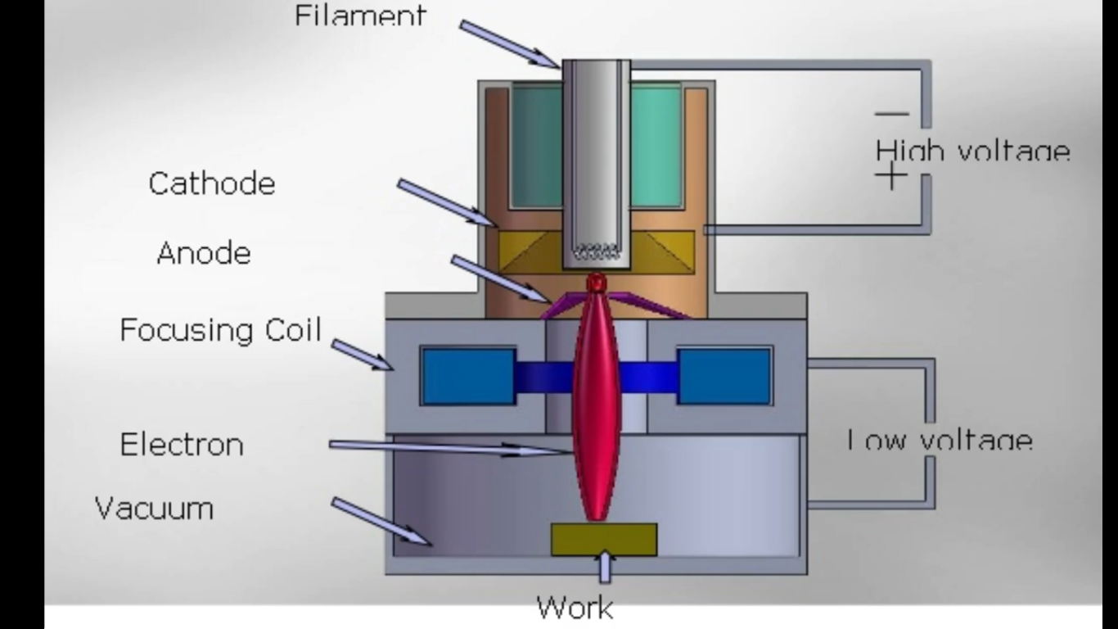
EBW: Electro beam welding

Slide 37
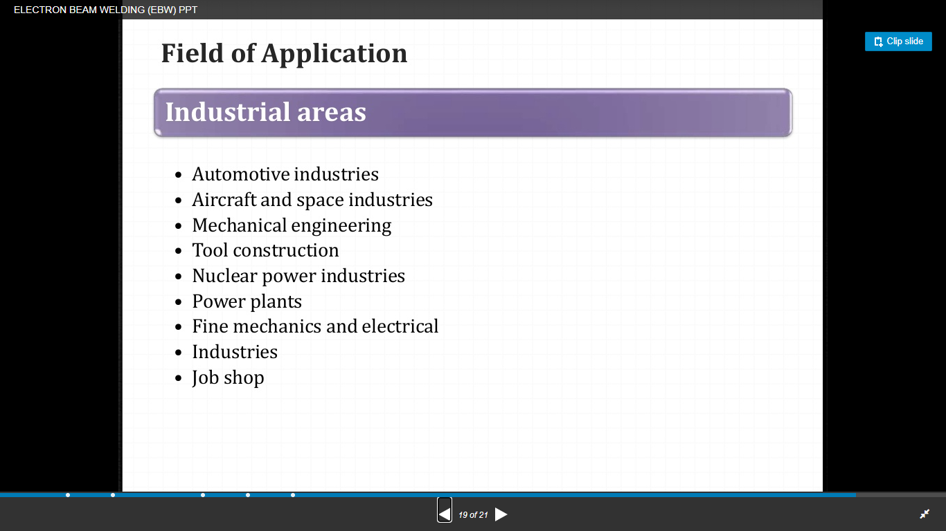
Applications:ebw

Slide 38
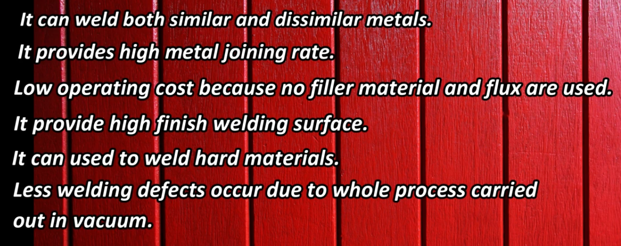
EBW: Advantages

Slide 39
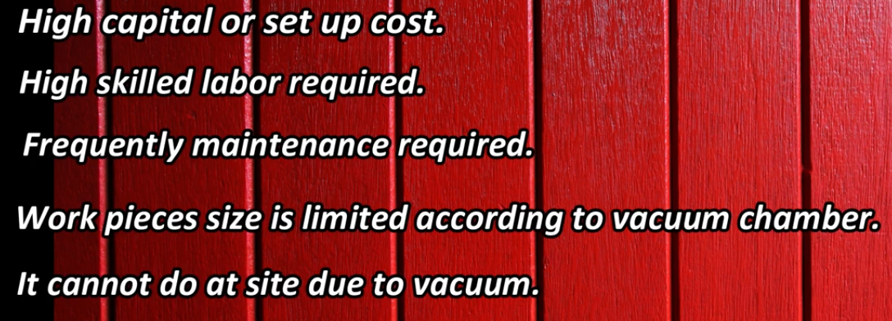
EBW: disadvantages

Slide 40
LBW: LASER beam welding
Laser beam equipment consists of a cylindrical ruby crystal with both the ends made absolutely parallel to each other. Ruby is aluminum oxide (AlO2) with chromium dispersed throughout it.
One of the end faces of the ruby crystal highly silvered so that it reflects nearly 96% of the incident light. In order to tap the laser output, the other end face of the crystal is partially silvered and contains a small hole through which the laser beam emerges.
The ruby crystal is surrounded by a helical flash tube containing inert gas ‘xenon’ which itself in turn is surrounded by a ‘reflector’ to maximize the intensity of the incident light on the ruby crystal. The flash tube converts electrical energy into light energy.
LASER:-Light amplification by stimulated emission of radiation

Slide 41
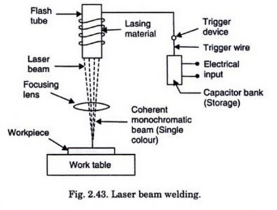
LBW: LASER beam welding

Slide 42
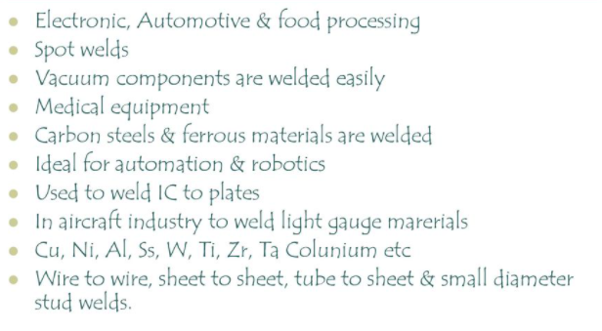
applications

Slide 43
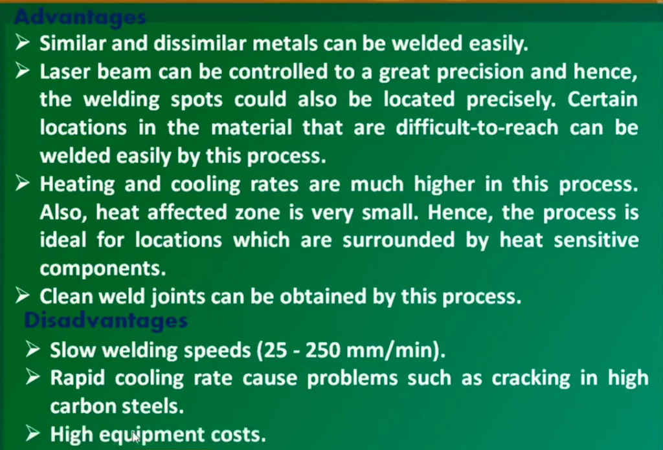
LBW: LASER beam welding

Slide 44
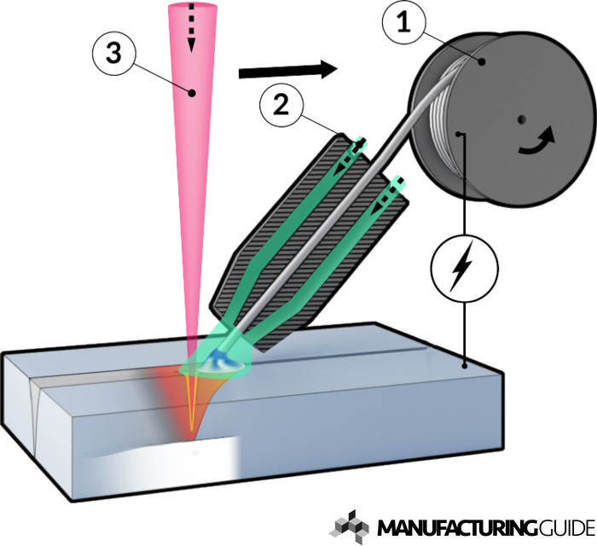
Hybrid welding
Laser-Hybrid welding is a combination of a laser process and an arc welding process, usually gas metal arc welding (GMAW).
A focused laser beam and the GMAW arc work together in a shared weld pool.
The filler material is introduced via the GMAW process.
The interaction between the laser process and the GMAW process creates an extremely stable welding process with a high deposition rate and a high degree of thermal efficiency.

Slide 45
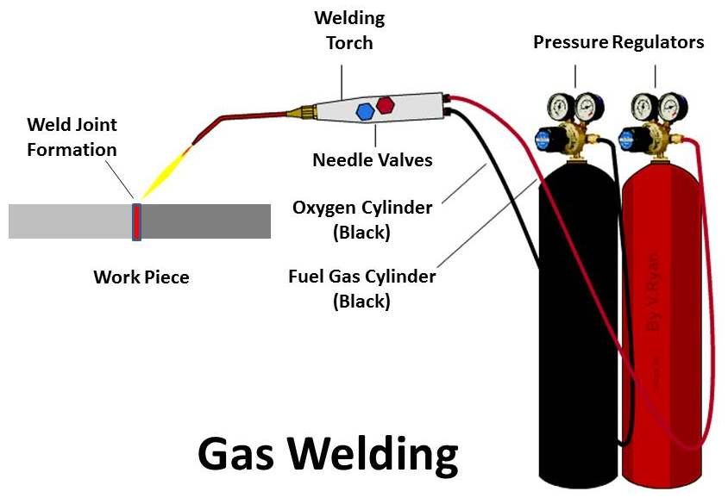
Oxyacetylene welding
Application of gas welding
Gas welding is used in a variety of industries. Here is a list of some of the most common applications of gas welding.
Repair works: One of the most common applications of gas welding is for repair works.
Fabrication of sheet metal: Thin to medium sheet metals are easily weld using gas welding.
Aircraft industry: Oxy-Acetylene welding is used in joining various aircraft parts.
Automotive industry: Used to weld parts of the frame and the chassis.
Joining High carbon Steel: Gas welding is very effective in melting high carbon steel.

Slide 46
Oxyacetylene welding
Advantages of gas welding
Certain key features of gas welding make it so popular in the field. We will discuss some of them here.
Weld ferrous and non-ferrous metals: One of the great strengths of gas welding is that it can weld non-ferrous and ferrous metals together.
No requirement for electricity: When we compare gas welding to the other popular weld methods like arc welding, gas welding does not require any electricity to operate. Hence, you can use gas welding in places that do not have access to electricity.
Cheap Equipment costs: The initial capital for gas welding is very low as it doesn’t require specialized machinery.
Doesn’t require specialized labor: Gas welding doesn’t require highly specialized labor. This makes it easier to find gas welders, as well as keeps the labor charge low.
Portable equipment: The whole setup for Gas Welding is easily portable.

Slide 47
Oxyacetylene welding
Disadvantages of gas welding
The popular term “no one-size-fits-all” is true for gas welding too. These are some of the disadvantages of using gas welding. These include:
Not suitable for thick sections
Cannot be used for high strength steel
The slow rate of heating
Cannot reach the temperatures of arc welding
Doesn’t have a dedicated flux shielding system

Slide 48
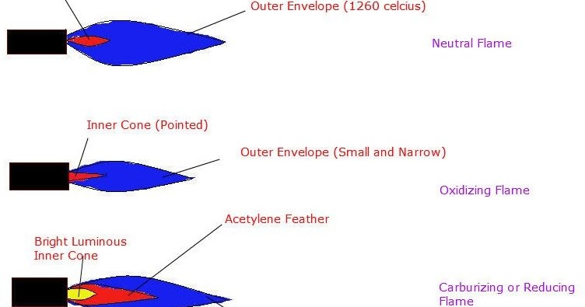
Flames: Oxyacetylene welding

Slide 49
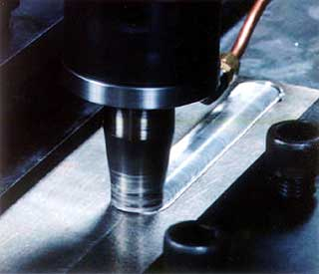
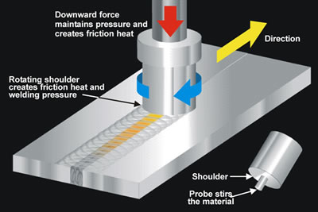
Friction stir welding

Slide 50
Applications:fsw
FSW is mostly used in aircraft industries for welding wings, fuel tanks, aircraft structure etc.
Used in marine industries for structure work.
Used in automotive industries to weld wheel rims, chassis, fuel tanks and other structure work.
It is used in chemical industries for joining pipelines, heat exchanger, air conditioner etc.
Friction stir welding is also used in electronic industries for joining bus bar, aluminum to copper, connectors and other electronic equipment’s.
It is widely used in fabrication industries.

Slide 51
Advantages:fsw
It is a solid state welding so does not use flux, filler metal etc.
FSW can be used to weld both similar and dissimilar metals.
Fine grain size and quality weld can be obtain by this process
Lower power consumption due to absence of external heating.
Highly automated.
Little maintenance required.
Large welding joint design available and it can weld in all direction.
Easy to operate and does not involve any environmental pollution.

Slide 52
Disadvantages: fsw
Complicated or special fixture arrangement required.
It creates a visible hole in welding plates.
High initial or setup cost.
It is less flexible compare to arc welding process.
FSW cannot make filler joints.
Non Forgeable material cannot be weld.

Slide 53


Spot welding or resistance welding
A form of resistance welding, spot welding is one of the oldest welding processes whereby two or more sheets of metal are welded together without the use of any filler material.

